Slide 1
Linearly Separable Data

Slide 2
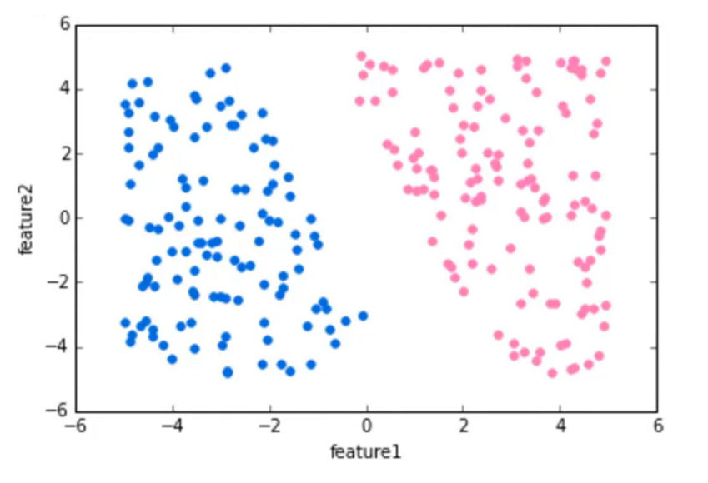

Slide 3
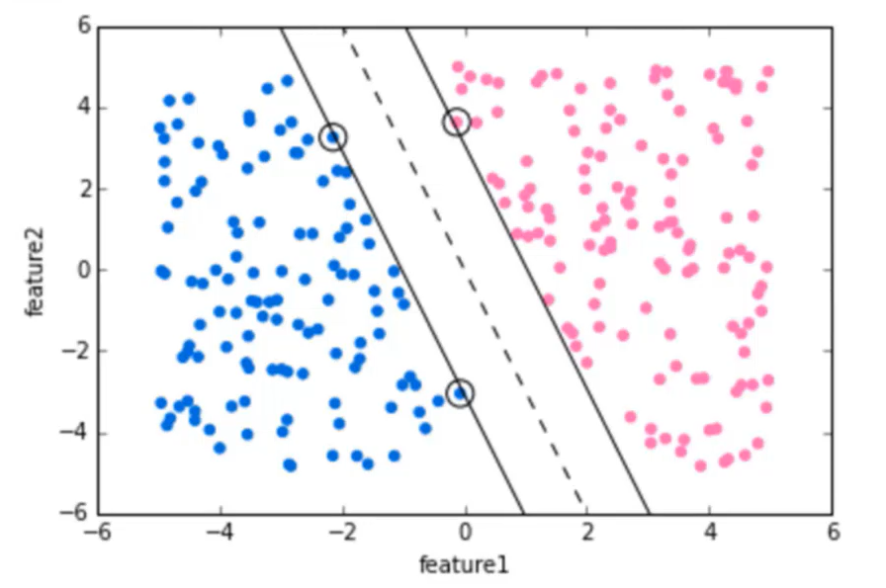

Slide 4
Non-Linearly Separable Data (Overlapping classes)

Slide 5
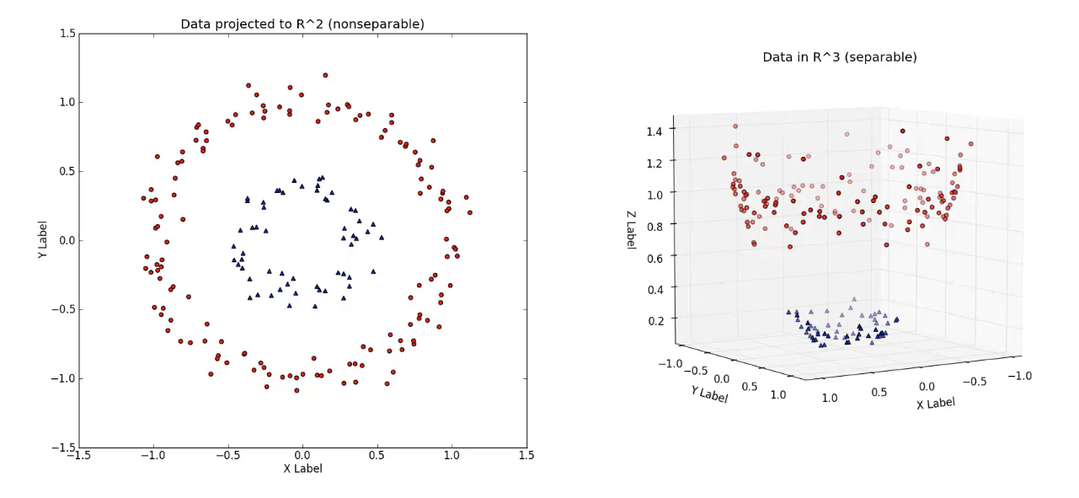

Slide 6
